Slide 1










Team Name:
Project Title
Simply tick the theme you have chosen. To know more details check our website www.hack4purpose.in
Hack from Senior
Hack from Native
Hack from Us
Hack from You
Problem & Solution
Give facts and data of the problem your solving:
Describe your solution in two lines:
Any queries in filling the ppt reach us anytime
+91 8925902116
+91 7904326057

Slide 2








Team members
Team Leader
Team member2
Team member3
Team member4
Guide 1
Full Name
Full Name
Full Name
Full Name
Guide Full Name
Role in project:
One thing you love about yourself:
Father&Mother’s Occupation:
Sibling Occupation:
Role in project:
One thing you love about yourself:
Father&Mother’s Occupation:
Sibling Occupation:
Role in project:
One thing you love about yourself:
Father&Mother’s Occupation:
Sibling Occupation:
Role in project:
One thing you love about yourself:
Father&Mother’s Occupation:
Sibling Occupation:
Qualification:
One thing you love about yourself:
Years of experience:
Domains of expertise:
Mention Names of your Senior’s here: (If you chose their old thesis for your project under Hack from Senior)

Slide 3


















SDG Impact
Include how big is the impact of your technology/solution to the benefit of people, planet and economy. Try to include numbers to show the impact.
Simply tick the Sustainable development goals that fit to your proposed solution

Slide 4

Unique features
Write in bullet points what are the unique/novel features or benefits of your technology
Unique feature 1
Unique feature 2
Unique feature 3
Unique feature 4
How affordable is your solution/technology?
When your technology/product solves a problem and is also affordable then it is a sure shot for success. So describe to us how you plan to make it affordable or why is it cost-effective?

Slide 5
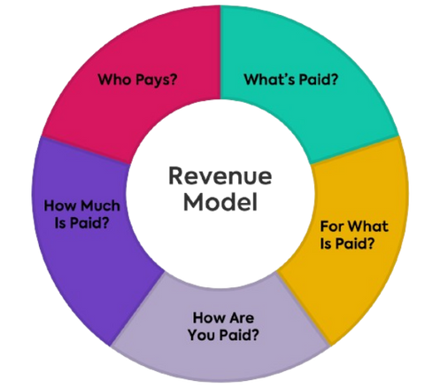
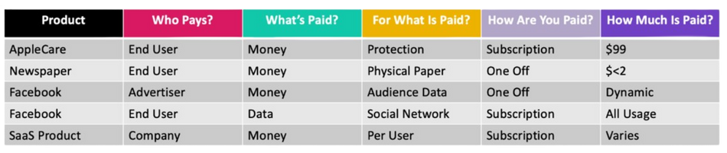





Target customers & Revenue model
Mode
Mention the mode of your technology/product if its B2B (Business to Business) or B2C (Business to Consumer) orD2C (Direct to Consumer)
Calculate your cost to produce the product/technology and the selling price. If you don’t have idea on this, then try to look at cost at which price your competitor is selling Ex: Your product is a Eco-friendly perfume check online for cost of eco-friendly perfume. Let’s assume its 1500 INR for 150ml then set your price at 1000 INR and plan how to make an eco-friendly perfume at 1000 INR
First calculate the cost of your making your product and add profit margin for you. This will give you the SELLING Price. Once the selling price is calculated you need to figure out the business model (How are you going to sell it and make people buy it). Most important of all
Who are you selling to? Who is your customer? Check the examples below
Selling price
Customers
Who are going to pay for your technology/product ? Is it Government or Corporates or MSMEs or export or consumers (their age group, geography, preference) ?
Payment
If your product is an app then you get payment through advertisements/subscription; If its a machine then you receive one time payment for the machine; If its a commodity then you receive payment through e-commerce or retail store; If its media then sponsors pay to showcase their product; If its service then your paid based on usage; If its platforms like connecting buyers or sellers then your payment is on commissions etc.

Slide 6

Market size & Competitors
Knowing your competition is important to build leverage. Check out the list of companies in the same field as your solution/technology and write down in bullet points the top companies in India and abroad
TAM
Competitor 1
Competitor 2
Competitor 3
Competitor 4
Total Available Market (TAM)
SAM
You can talk to potential customers and ask them to give you a score out of 10 or Like or Dislike or a 5 star rating and include it below. The more people you can talk to the more you get an idea of how you can make your product better. If your customers are common people (B2C or D2C) try talking to people in your circle in the particular age group your targeting. If your customers are businesses (B2B) like in case your developing a technology that can be used by corporates then try to reach out to people working in corporates through email or LinkedIN
Serviceable Available Market (SAM)
SOM
Serviceable Obtainable Market (SOM)
7/10
Market size basically indicates how many people we can sell to. In TAM Section, you can fill in the maximum amount of revenue (in USD or INR) your technology can make across the GLOBE. In SAM, you need to show the target market, specific countries you want to target first and the revenue of the same. In SOM, you show the revenue that is realistic and achievable in short-medium time period.
Include some potential customer feedback/inputs for extra points !

Slide 7
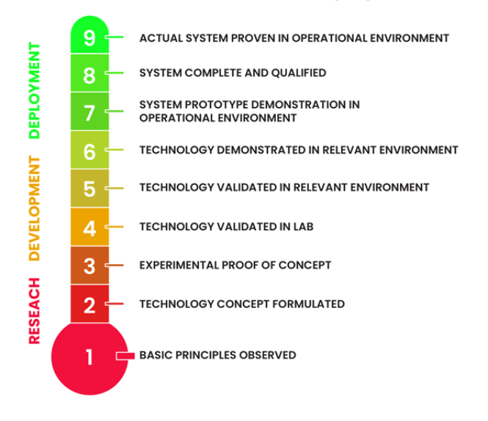
Milestones
Please assess your present TRL (Technology Readiness Level) and place tick mark against the 1-9 indicators on the left and write the month you plan to achieve next steps. Depending on your plan write the financial need. PLEASE MAKE SURE TO INDICATE THE TOTAL FUNDS NEEDED AND DURATION (Ex: 7 lakhs for the next 6 months to develop a working prototype)
Oct 2024
Sep 2024
Sep 2024
Description | Financial requirement
Example 1 (Materials to make prototype) | 2,50,000 INR
Example 2 (Lab testing) | 1,00,000 INR
Example 3 (Design/software support needed) | 2,00,000 INR
Example 4 (Travel, contingency/miscellaneous) | 1,50,000 INR
Aug 2024
Jul 2024
Jun 2024
Apr 2024
Mar 2024
Feb 2024
Any queries in filling the ppt reach us anytime
+91 8925902116
+91 7904326057

